Slide 1
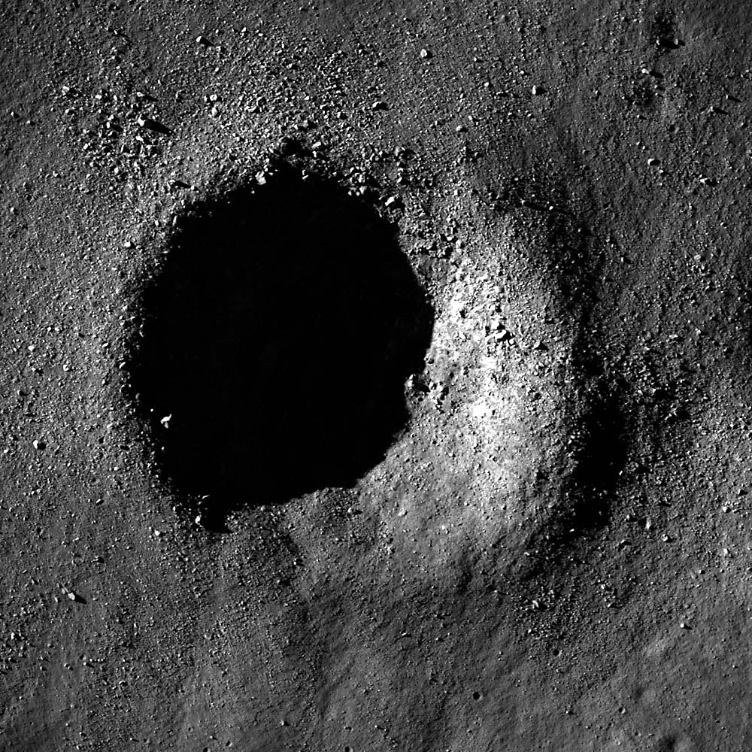
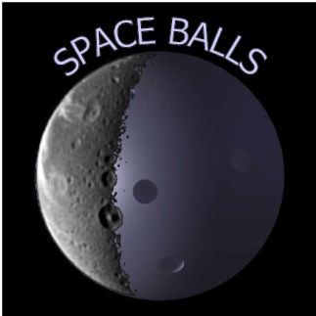

SPACE-BALLS
HELLIUMERS
Noelia Grande
Pablo Pingarrón
Francisco Rodríguez
Rosana Romero
Credits: NASA/Goddard/Arizona State University
NASA/JPL/Space Science Institute

Slide 2




Slide 3
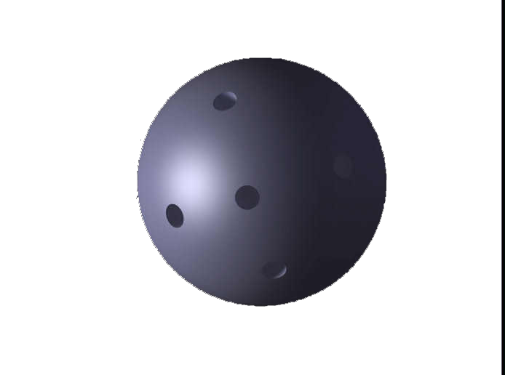
Multispectral instrument:
IR
Thermal
Sensors:
Temperature
Humidity
CO2
…
LIDAR or ToF:
Topography
SLAM (Bayesian Networks for mapping, as a roomba map)
Swarm of spheres:
ServoMotor
Power source
3 Giroscopes
Network link
Fast SLAM Algorithm

Slide 4
Credits: https://www.youtube.com/watch?v=2Eqy8nxX2X
https://www.youtube.com/watch?v=ovrkz12UFBM
Credits: https://www.youtube.com/watch?v=2Eqy8nxX2XY

Slide 5
Advantages of a Sphere Design
- Accesibility
- Solidity
Variable size
- Low weight
- Scalabilty
Credits: https://www.youtube.com/watch?v=2JMRbev1nvw
Technical challenges
Not sample collection, only exploration
Lunar dust
- Control of temperature

Slide 6






SPACE-BALLS
Reality for inspiration
Science for imagination
Let’s fill this hole with opportunities

Slide 7
GEOLOGIC CHARACTERISTICS OF THE NINE LUNAR LANDING MISSION SITES RECOMMENDED BY THE GROUP FOR LUNAR EXPLORATION PLANNING, Work performed for Office of Manned Space Flight, National Aeronautics and Space Administration under Contract NASW-417, May 1968
Detection of intact lunar lava tubes in the data from SELENE (Kaguya) radar sounding, T. Kaku (JAXA/Tokai University), J. Haruyama (JAXA), W. Miyake (Tokai University), A. Kumamoto (Tohoku University), K. Ishiyama (JAXA), T. Nishibori (JAXA), K. Yamamoto (NAOJ), S.T. Crites (JAXA), T. Michikami (Kinki University), Y. Yokota (Kochi University), R. Sood (The University of Alabama), H. J. Melosh (Purdue University), L. Chappaz (AstroLabs), K. C. Howell (Purdue University), American Geophysical Union Publications Geophysical Research Letters, DOI: 0.1002/2017GL074998
Clementine Titanium Map of the Moon, Copyright © 2018 - Lunar and Planetary Institute
References

